Slide 1
jQuery & AJAX

Slide 2
jQuery
jQuery is a library of JavaScript Functions.
jQuery is a lightweight "write less, do more" JavaScript library.
The jQuery library contains the following features:
HTML element selections
HTML element manipulation
CSS manipulation
HTML event functions
JavaScript Effects and animations
HTML DOM traversal and modification
AJAX
Utilities

Slide 3
Using jQuery
The jQuery library is stored as a single JavaScript file, containing all the jQuery methods.
It can be added to a web page with the following mark-up:
<head><script type="text/javascript" src="jquery.js"></script></head>

Slide 4
Using jQuery
If you don't want to store the jQuery library on your own computer, you can use the hosted jQuery library from Google or Microsoft.
Google
<head><script type="text/javascript" src="http://ajax.googleapis.com/ajax/libs/jquery/1.4.2/jquery.min.js"></script></head>
Microsoft
<head><script type="text/javascript" src="http://ajax.microsoft.com/ajax/jquery/jquery-1.4.2.min.js"></script></head>

Slide 5
jQuery Syntax
With jQuery you can select any HTML element in the HTML document and perform actions on it.
$(selector).action()
A dollar sign to define jQuery
A (selector) to "query (or find)" HTML elements
A jQuery action() to be performed on the element(s)

Slide 6
Examples
$(this).hide() -hides current element
$("p").hide() -hides all paragraphs
$("p.test").hide() -hides all paragraphs with class="test"
$("#test").hide() -hides the element with id="test"

Slide 7
Document Ready?
Make sure your document has finished loading before running any jQuery methods in your HTML document.
To prevent that the following piece of code goes before the jQuery action is called:
$(document).ready(function(){// jQuery functions go here...});

Slide 8
jQuery Selectors
jQuery selectors allow you to select HTML elements (or groups of elements) by element name, attribute name or by content.
There are 3 types of selectors
Element Selectors
Attribute Selectors
CSS selectors

Slide 9
Element Selectors
jQuery uses CSS selectors to select HTML elements.
$("p") selects all <p> elements.
$("p.intro") selects all <p> elements with class="intro".
$("p#demo") selects all <p> elements with id="demo"

Slide 10
Attribute Selectors
jQuery uses XPathexpressions to select elements with given attributes.
$("[href]") select all elements with an hrefattribute.
$("[href='#']") select all elements with an hrefvalue equal to "#".
$("[href!='#']") select all elements with an hrefattribute NOT equal to "#".
$("[href$='.jpg']") select all elements with an hrefattribute that ends with ".jpg".

Slide 11
CSS Selectors
jQuery CSS selectors can be used to change CSS properties for HTML elements.
The following example changes the background-color of all p elements to yellow:
$("p").css("background-color","yellow");

Slide 12
Some Examples
Syntax Description
$(this) Current HTML element
$("p") All <p> elements
$("p.intro") All <p> elements with class="intro"
$("p#intro") All <p> elements with id="intro"
$("p#intro:first") The first <p> element with id="intro"
$(".intro") All elements with class="intro"
$("#intro") The first element with id="intro"
$("ul li:first") The first <li> element of each <ul>
$("[href$='.jpg']") All elements with an href attribute that ends with ".jpg"
$("div#intro .head") All elements with class="head" inside a <div> element with id="intro"

Slide 13
jQuery Events
The jQuery event handling methods are core functions in jQuery.
Event handlers are method that are called when "something happens" in HTML. The term "triggered (or "fired") by an event" is often used.
It is common to put jQuery code into event handler methods in the <head> section

Slide 14
jQuery Events
The events or “functions” are triggered when another event is triggered. For example, the code snippet below hides all text in the paragraph when a button is clicked.
<script type="text/javascript" src="jquery.js"></script>
<script type="text/javascript">
$(document).ready(function(){
$("button").click(function(){
$("p").hide();
});
});
</script>

Slide 15
Some more events
Event Method Description
$(document).ready(function) Binds a function to the ready event of a document(when the document is finished loading)
$(selector).click(function) Triggers, or binds a function to the click event of selected elements
$(selector).dblclick(function) Triggers, or binds a function to the double click event of selected elements
$(selector).focus(function) Triggers, or binds a function to the focus event of selected elements.
$(selector).mouseover(function) Triggers, or binds a function to the mouseover event of selected elements

Slide 16
Useful jQuery Application
Click on the following links for advanced jQuery options:
jQuery Callback: A callback function is executed after the current animation is 100% finished
jQuery HTML: jQuery contains powerful methods (functions) for changing and manipulating HTML elements and attributes
jQuery CSS: Use the css() method to return or set properties and values.
Query AJAX: jQuery has a rich library of methods (functions) for AJAX development.

Slide 17
Assignment
Create a simple 10 questions flashcard on Java material.
Use the slideToggle method to reveal the correct answer when the user clicks on a button.
Use the fadeout method to reveal the next question.
Use the hide method to allow the user to hide the current date and time.

Slide 18
AJAX
AJAX stands for “Asynchronous JavaScript and XML”
AJAX is not a new programming language, but a new way to use existing standards.
AJAX is the art of exchanging data with a server, and updating parts of a web page - without reloading the whole page.
Traditional web pages that do not use AJAX must reload the entire page if the content should change.
AJAX Examples: Google Maps, Gmail, Youtube, and Google Search.

Slide 19
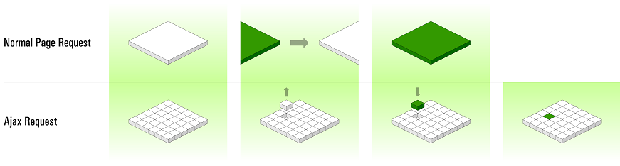
What AJAX Does?

Slide 20
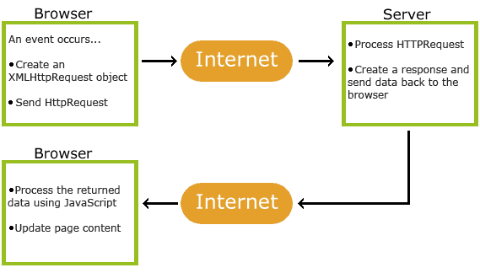
How AJAX Works? * Image courtesy- W3Schools
How AJAX Works

Slide 21
AJAX Standards
AJAX is based on internet standards, and uses a combination of:
XMLHttpRequest object (to exchange data asynchronously with a server)
JavaScript/DOM (to display/interact with the information)
CSS (to style the data)
XML (often used as the format for transferring data)

Slide 22
Using XMLHttpRequest
The JavaScript object XMLHttpRequest supports asynchronous communication with the server.
Send a Get or Post message to the server.
Don’t wait for a response.
Continue script operation.
If the message is XML or JSON we have good support for parsing and using it in both the DOM API and jQuery.
Get a text message back from the server.
Can be XML, JSON, or anything else.
Client and server have to agree on how to interpret the message.

Slide 23
Using XMLHttpRequest
JavaScript event fires when response is received from the server.
Event handler invokes a JavaScript callback function.
Callback function updates the page
by modifying the DOM
Has no necessary connection with XML.
JSON is favored by many JavaScript programmers.
JavaScript Object Notation

Slide 24
jQuery & AJAX
jQuery provides several methods for AJAX functionality.
Using the jQuery AJAX methods, you can request text, HTML, XML, or JSON from a remote server using both HTTP Get and HTTP Post - And you can load the external data directly into the selected HTML elements of your web page!
Implementing regular AJAX code can be a bit tricky, because different browsers have different syntax for AJAX implementation. This means that you will have to write extra code to test for different browsers. However, the jQuery team has taken care of this for us, so that we can write AJAX functionality with only one single line of code.

Slide 25
Jquery $.ajax() function
The jQuery $.ajax() function is used to Perform an asynchronous HTTP (Ajax) request.
jQuery.ajax( url [, settings ] )
url
Type: String
A string containing the URL to which the request is sent.
settings
Type: PlainObject
A set of key/value pairs that configure the Ajax request. All settings are optional.

Slide 26
$.ajax([settings])
The following are some of the settings that can be used:
accepts: The content type sent in the request header that tells the server what kind of response it will accept in return.
contentType: When sending data to the server, use this content type. Default is “application/x-www-form-urlencoded;charset=UTF-8” which is fine for most cases.
data: Data to be sent to the server. It is converted to a query string, if not already a string. Its appended to the url for GET-requests.
dataType: The type of data that you’re expecting back from the server (either an XML, HTML, SCRIPT or JSON)

Slide 27
$.ajax([settings])
success: A function to be called if the request succeeds. The function gets passed three arguments. The data returned from the server, formatted according to the dataType parameter; a string describing the status, and the jqXHR object.
statusCode: An object of numeric HTTP codes and functions to be called when the response has the corresponding code.
error: A function to be called if the request fails. The function receives three arguments: The jqXHR (in jQuery 1.4.x, XMLHttpRequest) object, a string describing the type of error that occurred and an optional exception object, if one occurred.

Slide 28
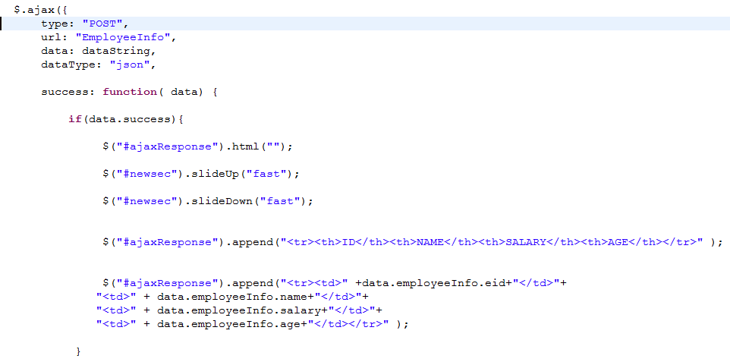
AJAX with Jquery example

Slide 29
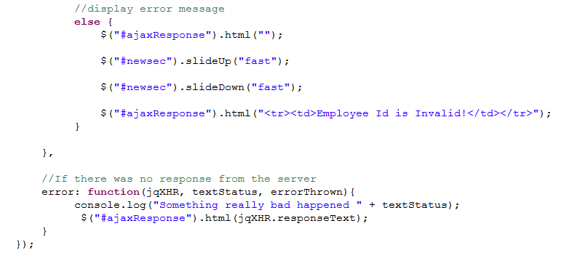
AJAX with Jquery example- continued

Slide 30
Assignment
Create an AJAX application that searches for an employee record and retrieves the employee information from the database. If employee ID is not found then the an error message “invalid ID” should be displayed. Use the $.ajax() function in jQuery to implement this functionality.

Slide 31
References
jQuery:
W3schools
jQuery API
jQuery with AJAX:
jQuery with AJAX

